Slide 1

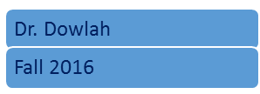

Slide 2
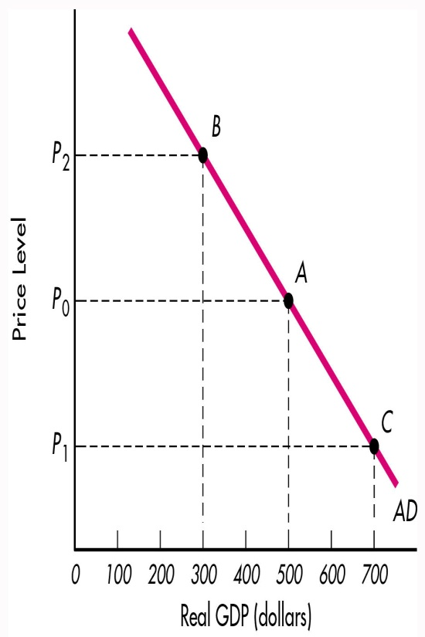
The Aggregate Demand Curve shows the demand side of an economy at various price levels.
Price level refers to overall inflation levels in an economy.
In other words, AD curve shows the overall expenditures in an economy at various inflation levels.
Real GDP and inflation levels move in opposite direction.

Slide 3
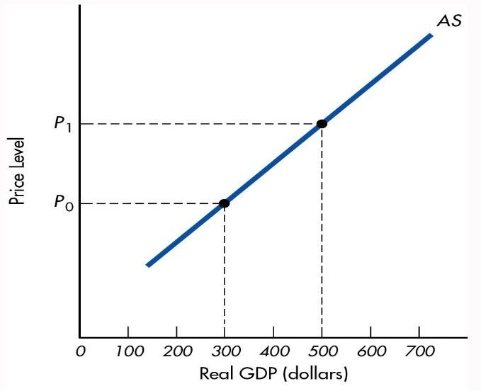
Aggregate Supply (AS) curve shows the output side in an economy at alternative price levels.
For example, when Price Level is P1, the real GDP is $500 billion. When Price Level is P0, real GDP is $300 bn.
AS and Price levels move in the same direction.

Slide 4

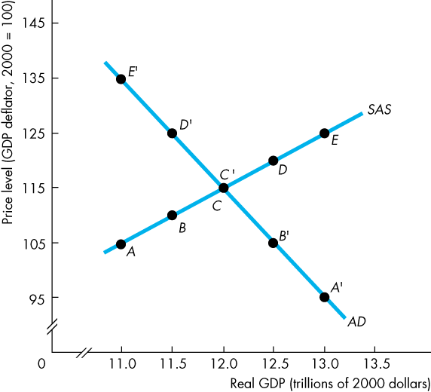
The Intersection of the AD and AS curves determines the equilibrium level real GDP (national output) and the Price level in the economy
If real GDP is below equilibrium GDP, firms increase production and raise prices…
… and if real GDP is above equilibrium GDP, firms decrease production and lower prices.
Dr. Dowlah/Spring 2016

Slide 5

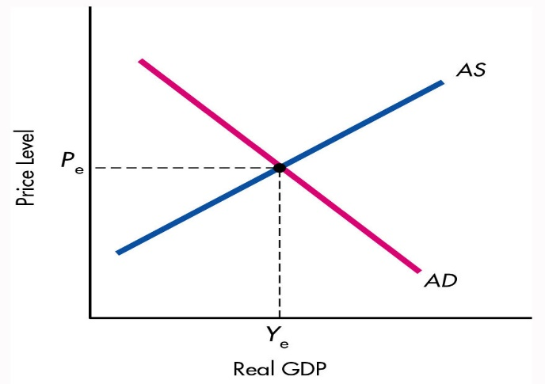
Once the equilibrium is established, there is no tendency for price levels or national output (real GDP) to change—until changes occur in either the AD Curve or the AS Curve.

Slide 6
There are two dominant schools of Economic Thought: the Classical School, founded by Adam Smith and the Keynesian Economics, founded by Lord John Maynard Keynes.
While Classical School of Thought emphasizes the supply-side economy, the Keynesian Economics emphasizes the demand-side economy.
In this class, we shall be applying Keynesian Economic Model to explain Aggregate Demand and Aggregate Supply in an economy.

Slide 7
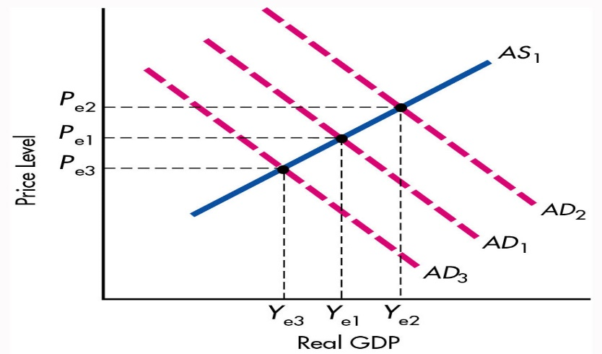
AD curve, in Keynesian Economics, is the most critical factor in determining macroeconomic equilibrium.
It is the AD curve, which determines different phases of Business Cycle in an economy.
If AD shifts to AD2—economy experiences an expansionary phase, when output rises
unemployment falls, and the economy experiences demand-pull inflation.

Slide 8

If AD1 shifts to AD3—economy experiences a contraction (recession).
As a result, real GDP declines,
unemployment rises,
price-level falls (inflation goes down).

Slide 9

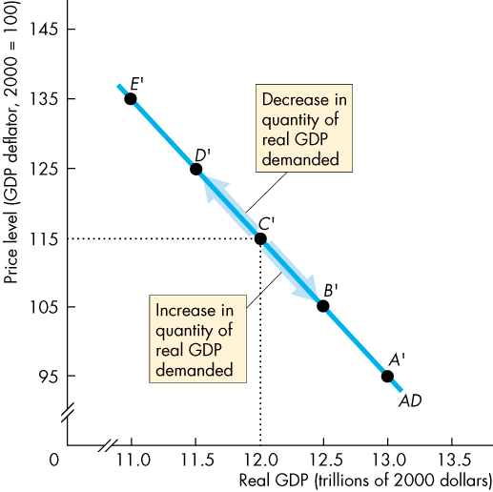
Changes in price levels lead to movements along the AD curve—it will not lead to a change in AD curve.
That means, the real GDP may go up or down, but the economy will be facing the same AD curve.
For example, at price level 115, real GDP will be $12 trillion. If price level rises to 135, the real GDP will be $11 trillion.

Slide 10

The quantity of real GDP demanded is the total amount of final goods and services produced in an economy. This quantity is the sum of consumption expenditures (C), investment (I), government expenditures (G), and net exports (X – M).
That means AD = C + I + G + X – M.
Dr. Dowlah/Spring 2016

Slide 11
Changes in any component of AD may cause a movement along the AD curve. Those components are the same as in GDP (expenditure approach):
Consumption (C)
Business investment (I)
Government purchases (G) and
Net exports (X-M)

Slide 12

1. Consumption—Household expenditures. Consumer expenditures depend on:
Income—what you earn for producing goods/services
B. Wealth=Accumulation of income over the course of time
C. Expectations—which can be positive or negative
D. Demographics—age-composition of a population, and
E. Taxes—which determines disposable income

Slide 13
2. Investment –Business Expenditures.
Business Investment depends on:
A. Profitability
B. Interest rate
C. Technology
D. Cost of capital goods
E. Capacity utilization

Slide 14
Government spending can be Discretionary and Non-discretionary
If the government spending is independent of the level of national income that is called discretionary spending.
For example, Mr. Bush, in 2008, signed into law the Troubled Asset
Relief Program (TARP) in October 2008 for $700 billion.
Mr. Obama signed into law $787 billion the American Recovery and Reinvestment Act (ARRA) in Feb. 2009.

Slide 15

Non-discretionary government spending includes transfer payments and entitlements, such as Social Security Benefits—unemployment allowances and so on.
Government must make these payments because of past laws. These are also called Entitlement Expenditures.

Slide 16
A. THE WEALTH EFFECT:
B. THE INTEREST RATE EFFECT:
C. THE INTERNATIONAL TRADE EFFECT:

Slide 17

4. Net exports are determined by----
A. Income: domestic income rises—import rises
B. Domestic versus foreign prices: higher domestic prices cause a fall in exports
C. Exchange rates: depreciation of US dollars makes foreign goods expensive, and
D. Government trade policies: tariff/custom rates affect international trade

Slide 18
Wealth Effect
A rise in the price level, ceteris paribus, decreases the amount of real wealth (money, stocks, etc.). To restore their real wealth, people increase saving and decrease spending. Thus, real GDP decreases. Similarly, a fall in the price level increases the amount of real wealth, which increases the amount of real GDP.
Dr. Dowlah/Spring 2016

Slide 19
A rise in the price level, ceteris paribus, decreases the real value of money and raises the interest rate.
When the interest rate rises, people borrow and spend less so the quantity of real GDP demanded decreases.
A fall in the price level causes reverses the course.
Dr. Dowlah/Spring 2016

Slide 20

A rise in the price level, ceteris paribus, increases the price of domestic goods relative to foreign goods. So imports increase and exports decrease, which decreases the quantity of real GDP demanded. Similarly, a fall in the price level increases the quantity of real GDP demanded.
Dr. Dowlah/Spring 2016

Slide 21

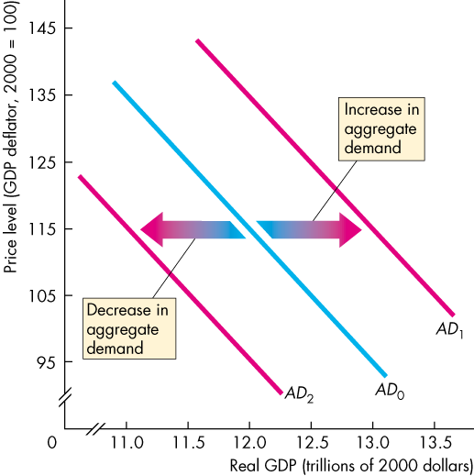
  When aggregate demand increases, the AD curve shifts rightward…
  When aggregate demand decreases, the AD curve shifts leftward.
Dr. Dowlah/Spring 2016

Slide 22
Only non-price level determinants can shift AD curve—when any of the following changes, AD shifts up or down (to the right or to the left).
A. Expectations
B. Foreign income and price levels
C. Government policies—fiscal and monetary

Slide 23
Aggregate Supply Curve (AS) shows total output in an economy at alternative price levels. It shows the output side of an economy—what will be supplied/produced in the economy at different price levels.
We distinguish three time frames associated with different states of the labor market:
A. Aggregate Supply Short-Run
B. Aggregate Supply Intermediate Run
C. Aggregate Supply Long-Run
Dr. Dowlah/Spring 2016

Slide 24
Short-Run Aggregate Supply shows the relationship between the quantity of real GDP supplied and the price level when other factors, such as the money wage rate, the prices of other resources, and potential GDP, remain constant.
  A rise in the price level with no change in other factors increases the quantity of real GDP supplied.
  The aggregate supply short-run curve is upward sloping.
Dr. Dowlah/Spring 2016

Slide 25
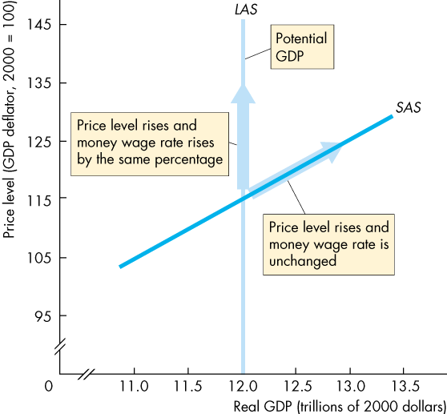
In the short run, the quantity of real GDP supplied increases if the price level rises.
The SAS curve slopes upward.
A rise in the price level induces firms to increase production.
Dr. Dowlah/Spring 2016

Slide 26
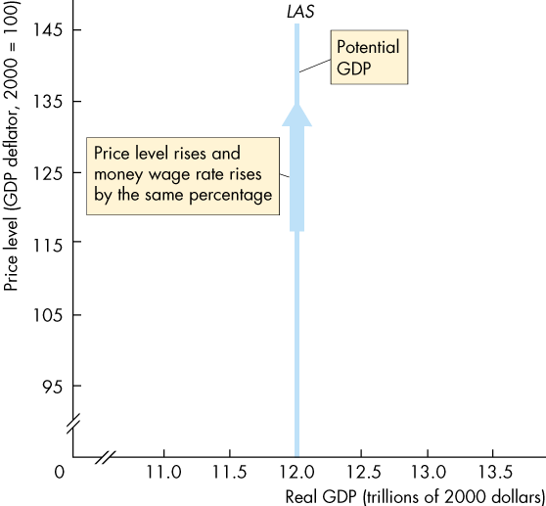
Aggregate Supply Long Run shows the relationship between the quantity of real GDP supplied and the price level when real GDP equals potential GDP.
  Potential GDP is independent of the price level.
  So the long-run aggregate supply curve (LAS) is vertical at potential GDP.
Dr. Dowlah/Spring 2016

Slide 27

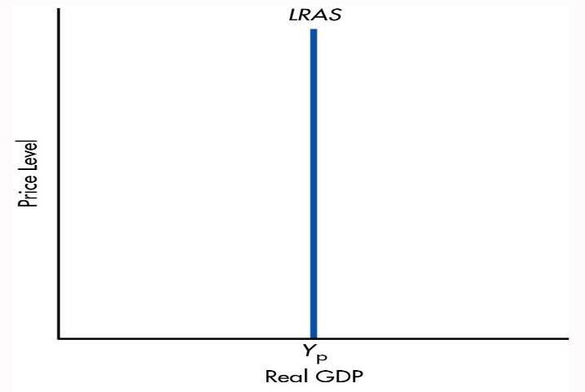
The Long-Run Aggregate Supply Curve is vertical—it shows the economy’s full employment level—or natural level of real output.
Full employment means the economy is at the acceptable rate or natural level of unemployment.
Dr. Dowlah/Spring 2016

Slide 28
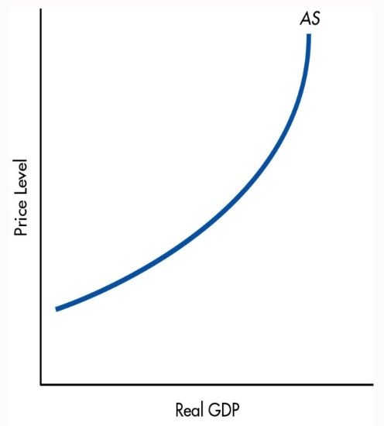
The short-run aggregate supply curve gradually adjusts to the price levels in the economy—it happens due to time-lag between adjustment of input prices and output prices. The steeper the slope becomes, the less the GDP increases, and the more the price –level rises.
Dr. Dowlah/Spring 2016

Slide 29

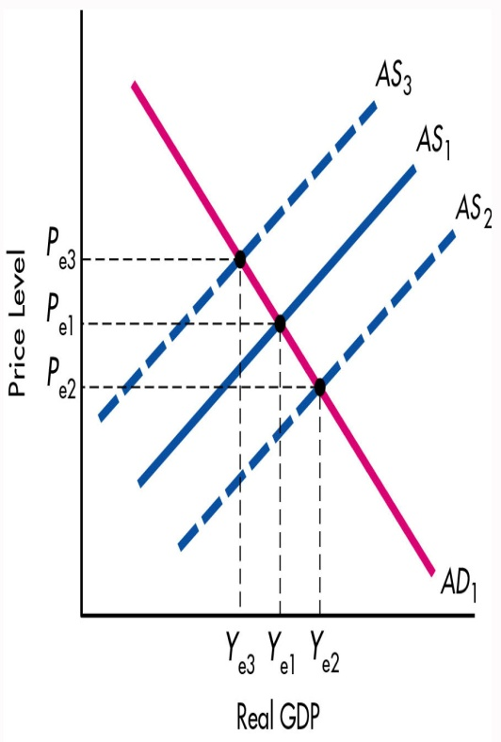
AS shifts because of non-price level factors, such as:
A. Resource Prices
B. Technology
C. Expectations
Dr. Dowlah/Spring 2016

Slide 30

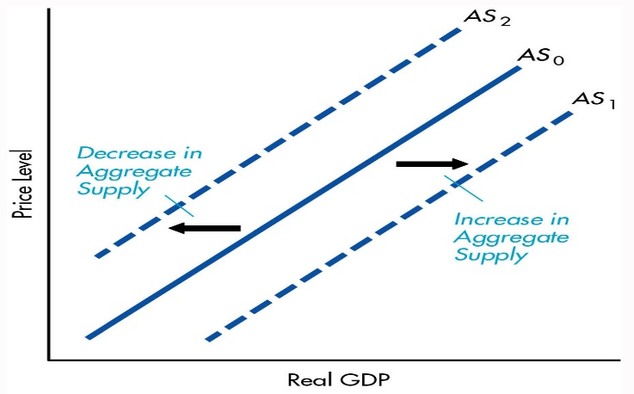
If Aggregate Supply shifts to the right, real GDP increases and price falls.
If AS shifts leftward, real GDP falls, and price level rises.
Dr. Dowlah/Spring 2016

Slide 31
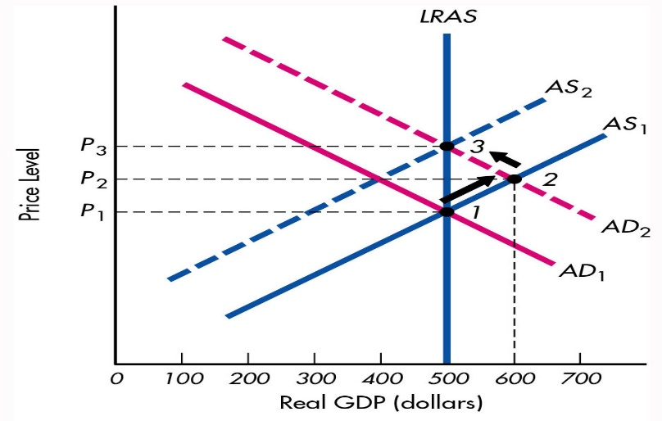
For an economy to be in long-run equilibrium—three curves must intersect—
Aggregate Supply Short Run,
Aggregate Supply Long Run, and
Aggregate Demand
Dr. Dowlah/Spring 2016

Slide 32
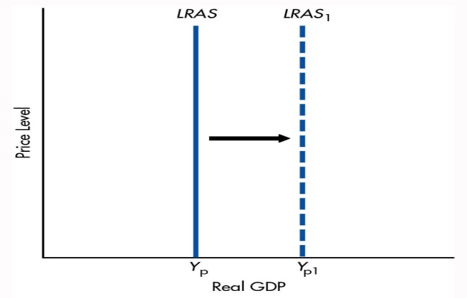
The Long-Run Aggregate Supply Curve (LAS) can shift in both directions.
LRAS shifts to the left means the country’s real GDP declining, and shifts to the right means the country’s real GDP is rising.
Rightward shift means economic expansion or positive growth, and Leftward shift means decline of an economy—negative growth.
Dr. Dowlah/Spring 2016

